Slide 1
Forecasting fine grained pollutant levels
^{Nilesh Patil Jiang Shang}

Slide 2
Background
What are fine grained pollutants?
The term fine grained pollutants refers to the particles in atmosphere having size smaller than 2.5μm.
Natural sources : Oceanic salt sprays , Volcanic activity, storms, forest and grassland fires etc.
In recent times, human activities like increasing usage of fossil fuels has led to significant jump in anthropogenic aerosols (those made by human activity) and it now accounts for about 10% of total
PM2.5 is particularly dangerous with a 36% increase in lung cancer per 10 μg/m3 beyond current safety standards
Problem Statement
Building a predictive model for PM2.5 levels based on historical conditions
Input : Temperature, Pressure, RH, Wind speed etc.
Output : PM2.5 level in next 24 hours
Potential Significance
Health alerts
Supplementing pollution control measures
Notes:
Dr. Yu Zheng initiates the study of inferring real-time and fine-grained air quality throughout a city using BigData. The cities he’s done this study include Beijing, Shanghai, Shenzhen, and Wuhan.
Fine grained pollutants refers to the particles in atmosphere having size smaller than 2.5 micrometer. They are referred as PM2.5 by United States EPA(Environmental Protection Agency)
Building a predictive model for PM2.5 levels across USA
In every pollutant monitoring study, fine grained particulate measurements are mentioned alongside the gaseous pollutants. They are especially dangerous with a 36% increase in lung cancer per 10 microgram per cubic meter beyond current safety standards. Since they are so small and light, they stay longer in air and this increase the chances of human and animals inhaling.
Most cities issue health alerts in USA and the better a forecast is, the more effective it is. A reliable forecasts provides the local authorities an opportunity to issue area specific measures for controlling particulate levels.

Slide 3
Methodology Overview
Data
Model
Data source
EPA(United States Environmental Protection Agency)
Data munging
From hourly readings to daily averages
579 counties spread across US
Weekly averages for each county
Monthly average for each county
Each row represents one county, one day and corresponding values for the previous day
Replace missing values based on matrix imputation instead of mean for each variable
Parameters used
Temperature, Pressure, Relative Humidity, Wind speed, Dew point, Ozone, SO₂, CO, NO₂
General modeling approach:
Use historical readings for physical parameters
Use month and weeks as categorical inputs
Algorithms of choice
Linear Regression
Random Forest
Xgboost
Validation
70:30 training-test division
10 fold cross validation for training dataset (linear regression)

Slide 4
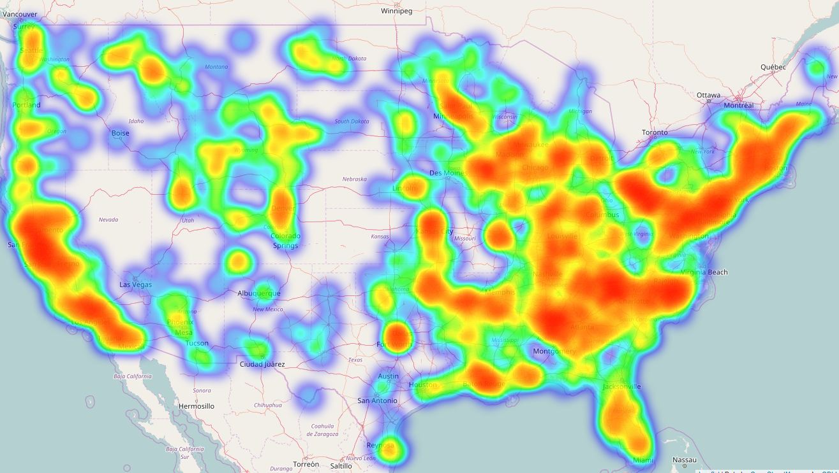
Relative average PM values (yearly)
PM2.5 concentration across USA : correlates highly with human activity and sea face

Slide 5
Linear Regression
Easier to analyze the model & straight forward to explain using just linear coefficients
Predictions :
First 2 plots show results on training and testing datasets with size set to the error
As shown, the linear regression model is not very accurate even though MSE and R2 are low, especially R2
The error increases linearly w.r.t. The actual PM2.5 value
Even at lower PM values, the model isn’t predictive at all

Slide 6
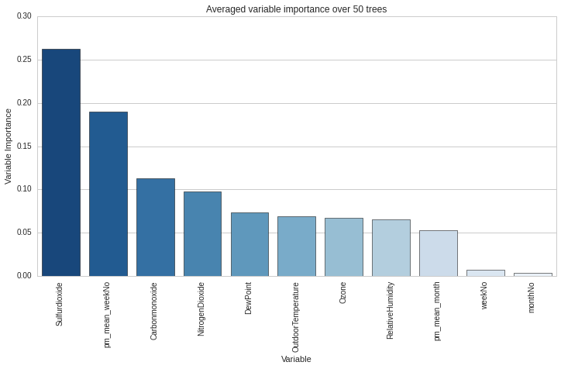
Random Forest - preliminary parameter search

Slide 7
Random Forest – current model results
Model:
Using grid search over a limited space, we used 35 trees and nvars at each split = log2(subset_vars)
Predictions :
First 2 plots show results on training and testing datasets with size set to the error
The third plot lays out predicted vs actual only and as we can see, our random forest model is doing a much better job than linear regression model, yet there are a few values being predicted incorrectly by huge margins as shown in the second plot
The fourth plot shows error distribution w.r.t. actual values in the test dataset

Slide 8
Problems & further work
Missing values :
Using matrix imputation, we filled in the missing values
We used :
multiple matrix imputation averaged for each value
Multivariate Imputation by Chained Equations
The results aren’t representative of the original dataset, most values are close to zero and we still haven’t figured out how to solve this issue.
One way is to use convex optimization based & KNN-based matrix imputation but the current implementations require 4.3 Tb memory
Variables :
We have used historical PM aggregates (weekly, monthly)
We still haven’t tried out historical values for other parameters
We would welcome suggestions for additional data that can be included on the city level.

Slide 9
Reference
Yu Zheng, Furui Liu, and Hsun-Ping Hsieh. 2013. U-Air. Proceedings of the 19th ACM SIGKDD international conference on Knowledge discovery and data mining - KDD '13 (August 2013). DOI:http://dx.doi.org/10.1145/2487575.2488188
Anon. Air pollution and lung cancer incidence in 17 European cohorts: prospective analyses from the European Study of Cohorts for Air Pollution Effects (ESCAPE). Retrieved July 10, 2013 from https://www.ncbi.nlm.nih.gov/pubmed/23849838
https://aqsdr1.epa.gov/aqsweb/aqstmp/airdata/download_files.html

